Slide 1



KONGU ENGINEERING COLLEGE
(AUTONOMOUS)
PERUNDURAI, ERODE - 638060
Department of Computer Science and Engineering
22CSP72 – PROJECT WORK II PHASE I
RetinaGuard: A Clinical Decision Support System for the Diagnosis of Retinitis Pigmentosa
TEAM ID – B19
PRESENTED BY:
23CSR110 - KIRAN SEKAR C
23CSR119 – LOKESH P
23CSR124 – MANOJ P
MENTOR: DR. N. SASIPRIYAA
Notes:
9/11/2024
1
1-59

Slide 2

PROBLEM STATEMENT
Retinitis Pigmentosa (RP) is a rare genetic eye disease leading to severe vision loss and blindness.
Current deep learning models often work only on clean, ideal datasets and fail in real-world clinical images.
Traditional AI is a “black box” and can misdiagnose:
Existing systems fail to detect RP variants like:
They also cannot adapt well to low-quality images from affordable handheld cameras.
camera flash artifacts
stitched image borders
unrelated diseases such as AMD and Diabetic Retinopathy
  Sine Pigmento
  Sectoral RP
Notes:
9/11/2024
2
1-59

Slide 3
OBJECTIVE
Build a reliable RP diagnosis system for real clinical and low-quality images
Make the diagnosis explainable and clinically interpretable, not a black-box AI
Detect rare RP variants like Sine Pigmento, RPA, and Sectoral RP
Avoid false positives from camera artifacts, flash, and unrelated retinal diseases
Support affordable handheld and smartphone fundus cameras
Provide clear clinical guidance, monitoring recommendations, and differential diagnosis
Notes:
9/11/2024
2
1-59

Slide 4
LITERATURE SURVEY
Paper | Contribution / Focus | Relevance to this Project | Key Limitation Exploited
ConvGRU‑U‑Net for RP vs CORD (Skublewska‑Pasz,2024) | ConvGRU + U‑Net classifies RP vs CORD on ultra‑widefield and FAF images. | Shows segmentation + recurrent features improve retina disease classification on small datasets. | Single‑centre, small dataset with limited device diversity; needs multi‑centre validation.
DCGAN augmentation + VGG16+XGBoost (Powroznik, 2025) | DCGAN synthesizes RP images; VGG16 features + XGBoost classifier improve detection. | Demonstrates GAN augmentation substantially boosts classifier performance for rare‑disease datasets. | Risk of synthetic bias and limited clinical validation; realism must be confirmed by experts.
WGAN‑GP for Synthetic Retinal Image Generation (Anaya‑Sánchez et al., 2025) | WGAN‑GP generates high‑fidelity retinal images (low FID, high SSIM); improves classifier generalization. | Validates advanced GANs for sensor‑robust augmentation across imaging devices and datasets. | Mostly evaluated on DR datasets; RP‑specific validation still required.
Notes:
9/11/2024
3
1-59

Slide 5
RESEARCH GAP IDENTIFIED
Most models fail on low‑quality clinical and handheld camera images.
Rare RP variants (sine pigmento, sectoral RP) are frequently missed.
Black‑box models lack clinical explainability for trustworthy decisions.
Data scarcity and class imbalance limit rare‑disease performance.
Synthetic augmentation risks bias without expert validation.
No integrated pipeline combines quality checks, explainability, and exportable reports.
Notes:
9/11/2024
4
1-59

Slide 6
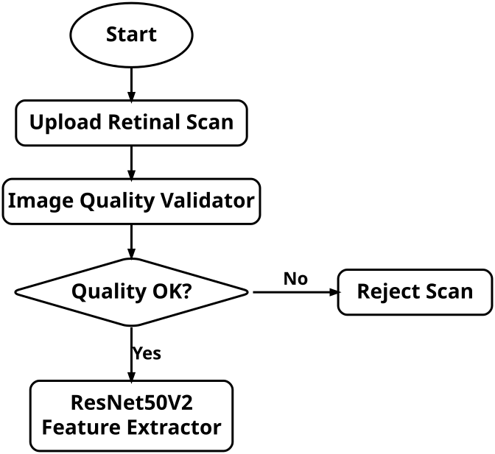
ARCHITECTURE DIAGRAM
Notes:
9/11/2024
5
1-59

Slide 7
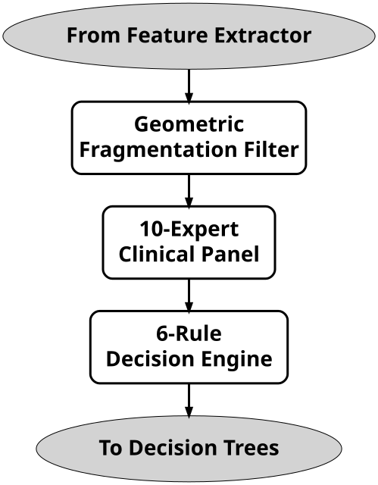
Cont…ARCHITECTURE DIAGRAM
Notes:
9/11/2024
5
1-59

Slide 8
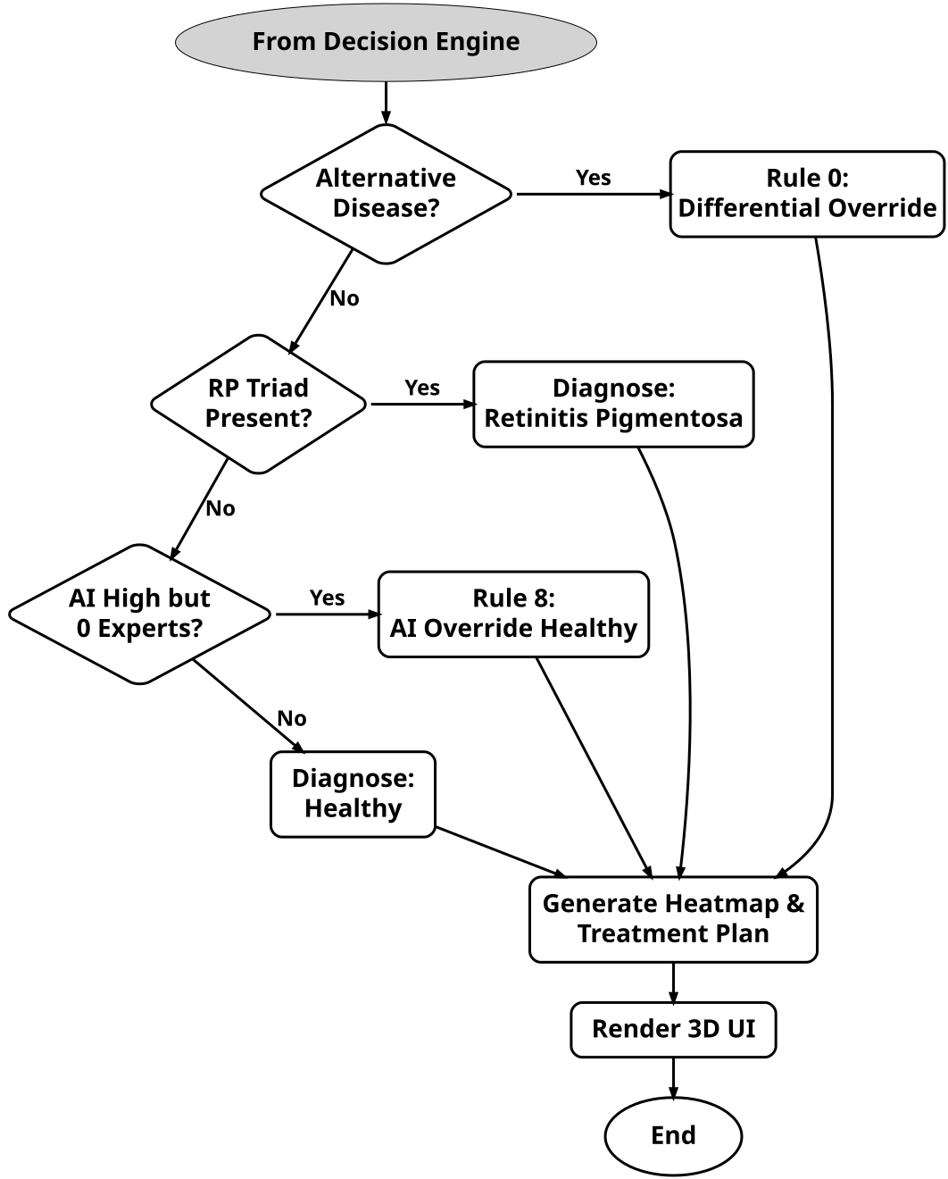
Cont…ARCHITECTURE DIAGRAM
Notes:
9/11/2024
5
1-59

Slide 9
PROPOSED INNOVATION
Hybrid AI Architecture
Explainable Clinical Decision Making
Real-World Image Adaptation
4. False-Positive Reduction and Rare Variant Support
Combines CNN-based prediction with expert retinal feature analysis.
Improves reliability compared with a single black-box model.
Validates AI output using medically meaningful RP signs.
Helps doctors trust and understand the diagnosis.
Handles poor-quality, handheld, and artifact-prone fundus images.
Applies calibration and enhancement for practical clinical use.
Differentiates RP from mimicking diseases and image artifacts.
Improves detection of rare RP variants using synthetic data.
Notes:
9/11/2024
5
1-59

Slide 10
MODULES OF THE PROJECT
Image Quality Validator (IQV) & Calibration Module
10-Expert Anatomical Feature Extraction Module
Deep Learning Core Classification Module (CNN)
Patient History & Clinical Risk Profiler Module
8-Rule Decision Engine & Differential Diagnosis Module (Novelty)
Explainable AI (XAI) & FDA 510(k) Report Generator (Novelty)
Clinical Dashboard & Interface Module
Notes:
9/11/2024
3
1-59

Slide 11
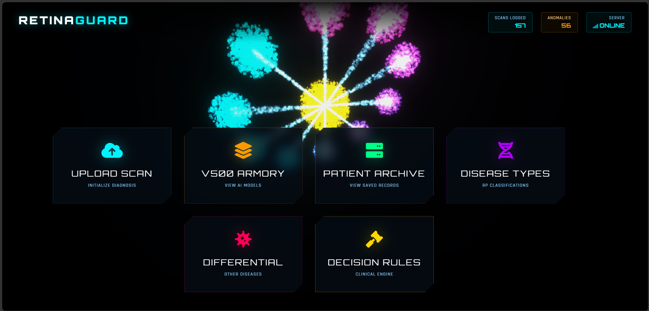
IMPLEMENTATION
Notes:
9/11/2024
3
1-59

Slide 12
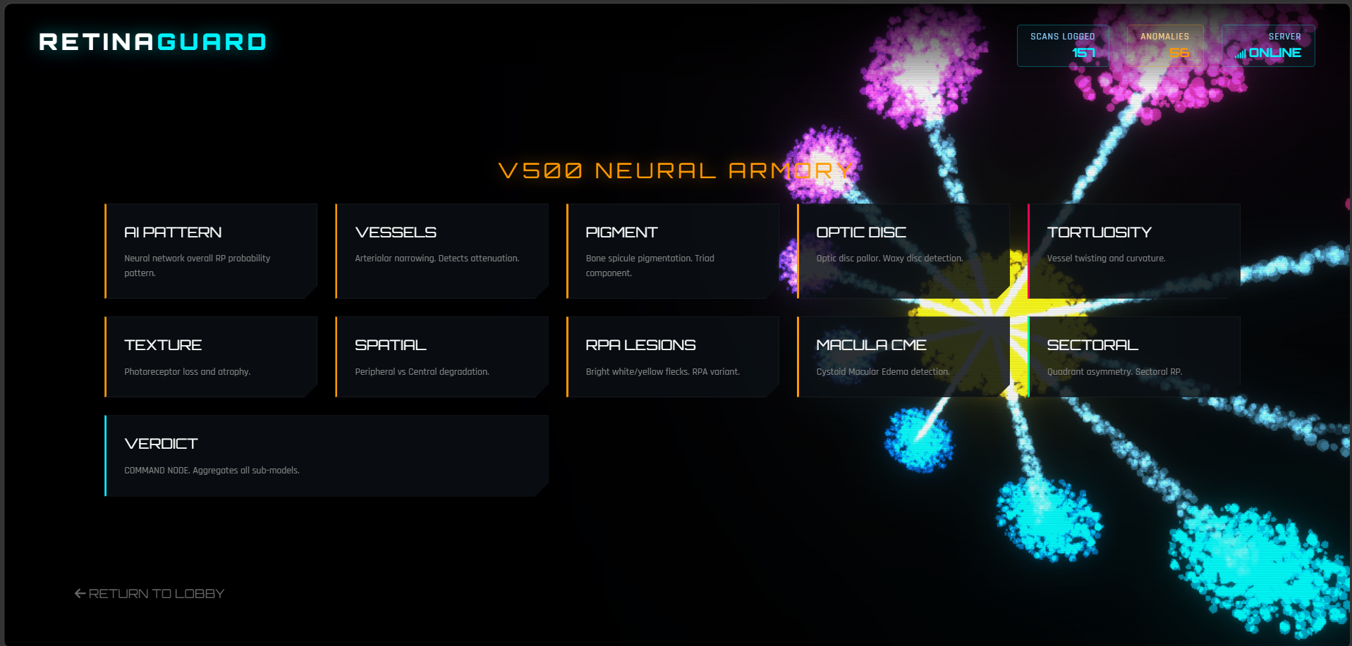
Notes:
9/11/2024
3
1-59

Slide 13
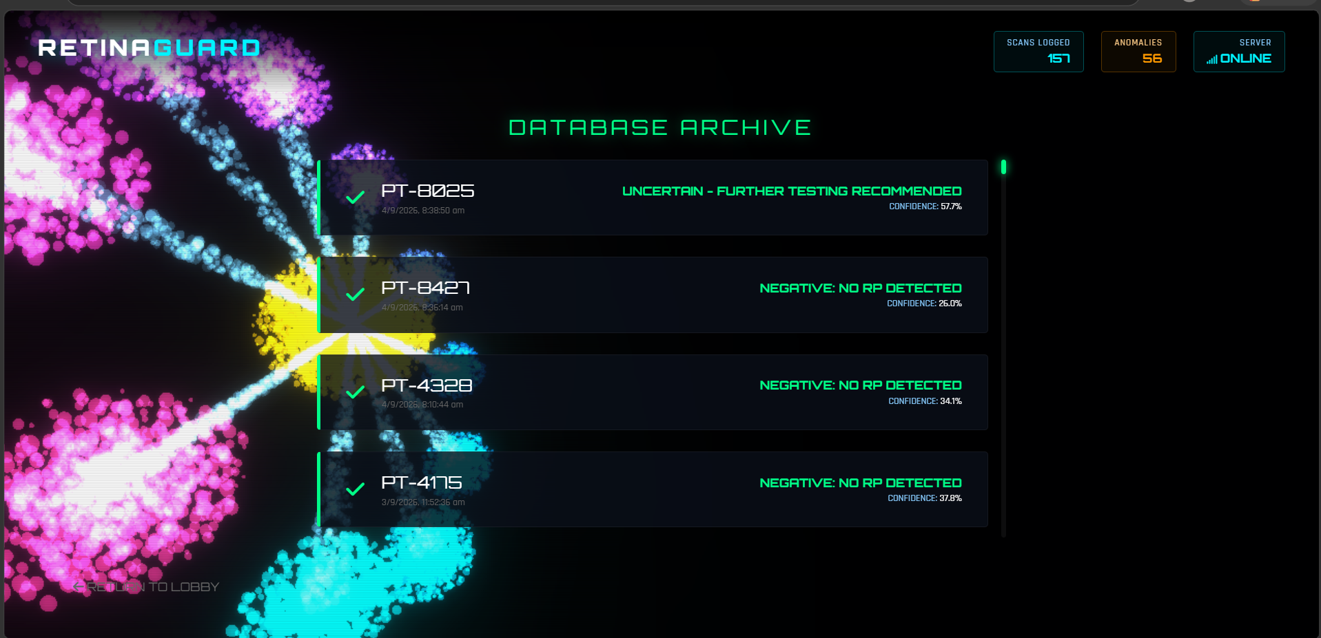
Notes:
9/11/2024
3
1-59

Slide 14
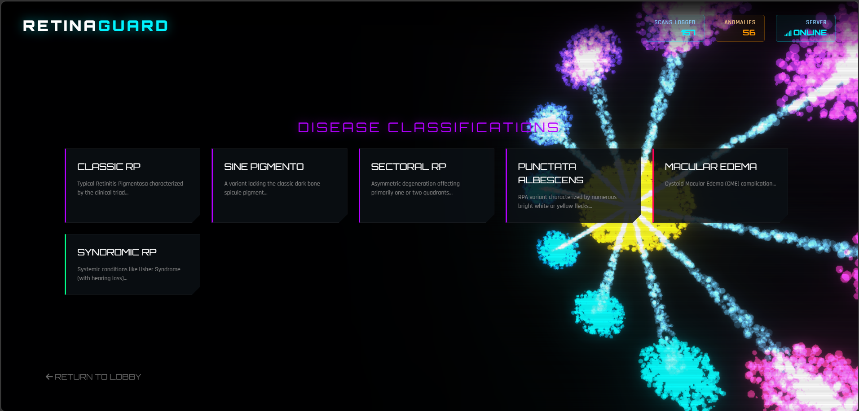
Notes:
9/11/2024
3
1-59

Slide 15
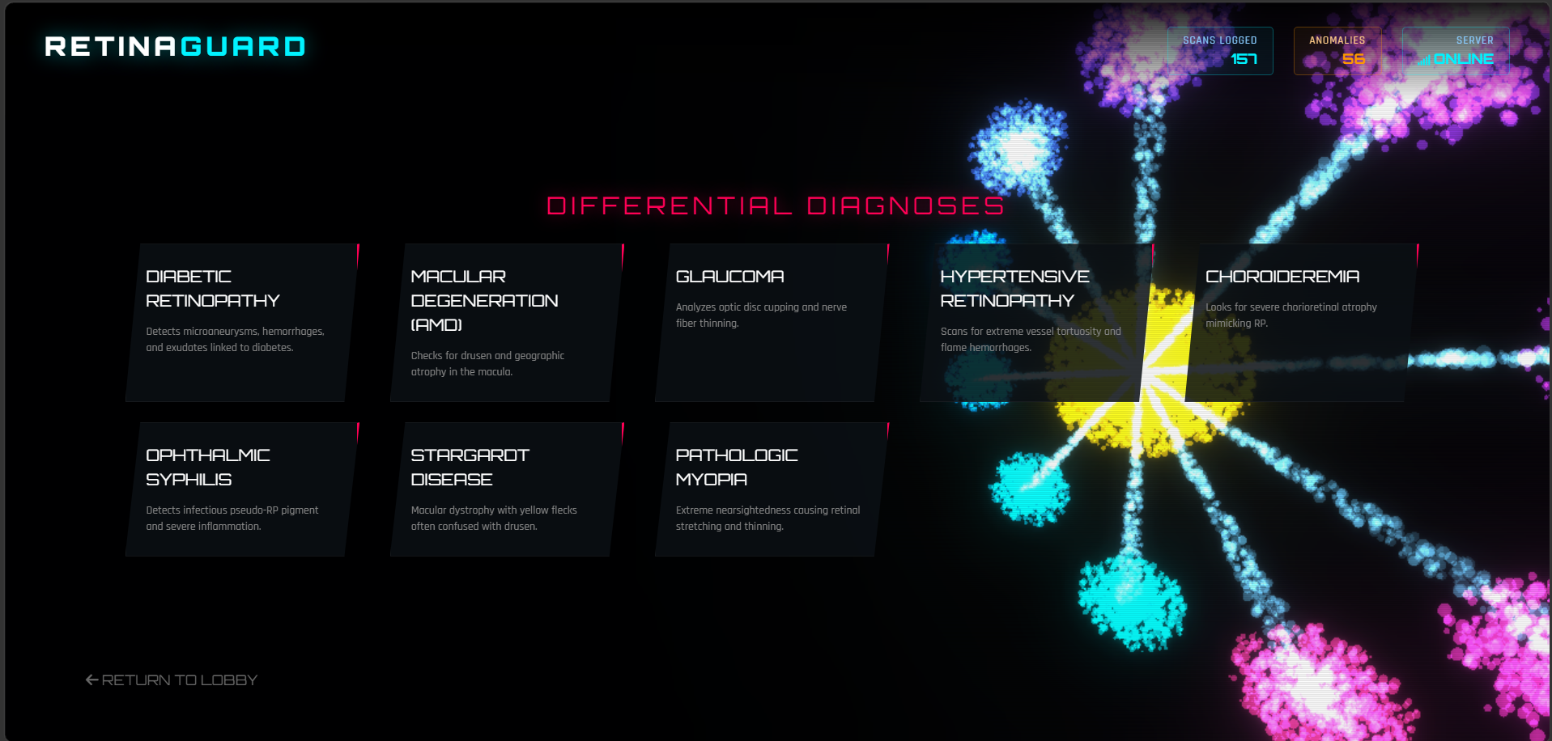
Notes:
9/11/2024
3
1-59

Slide 16
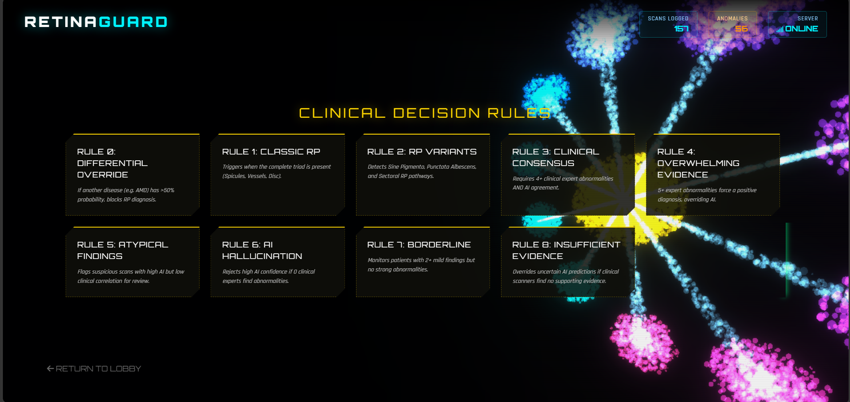
Notes:
9/11/2024
3
1-59

Slide 17
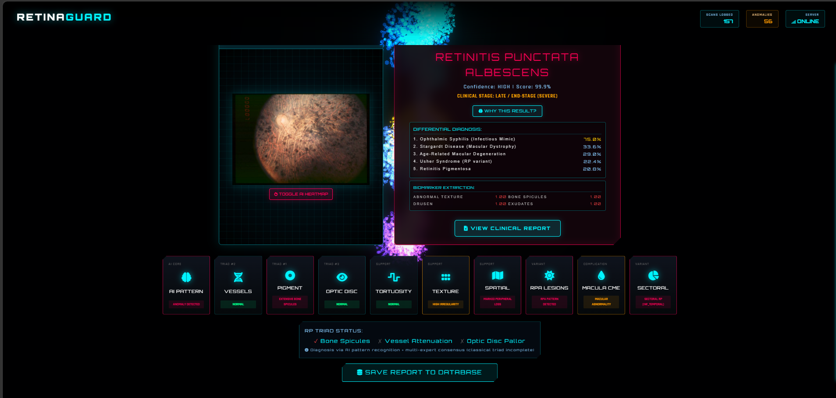
Notes:
9/11/2024
3
1-59

Slide 18
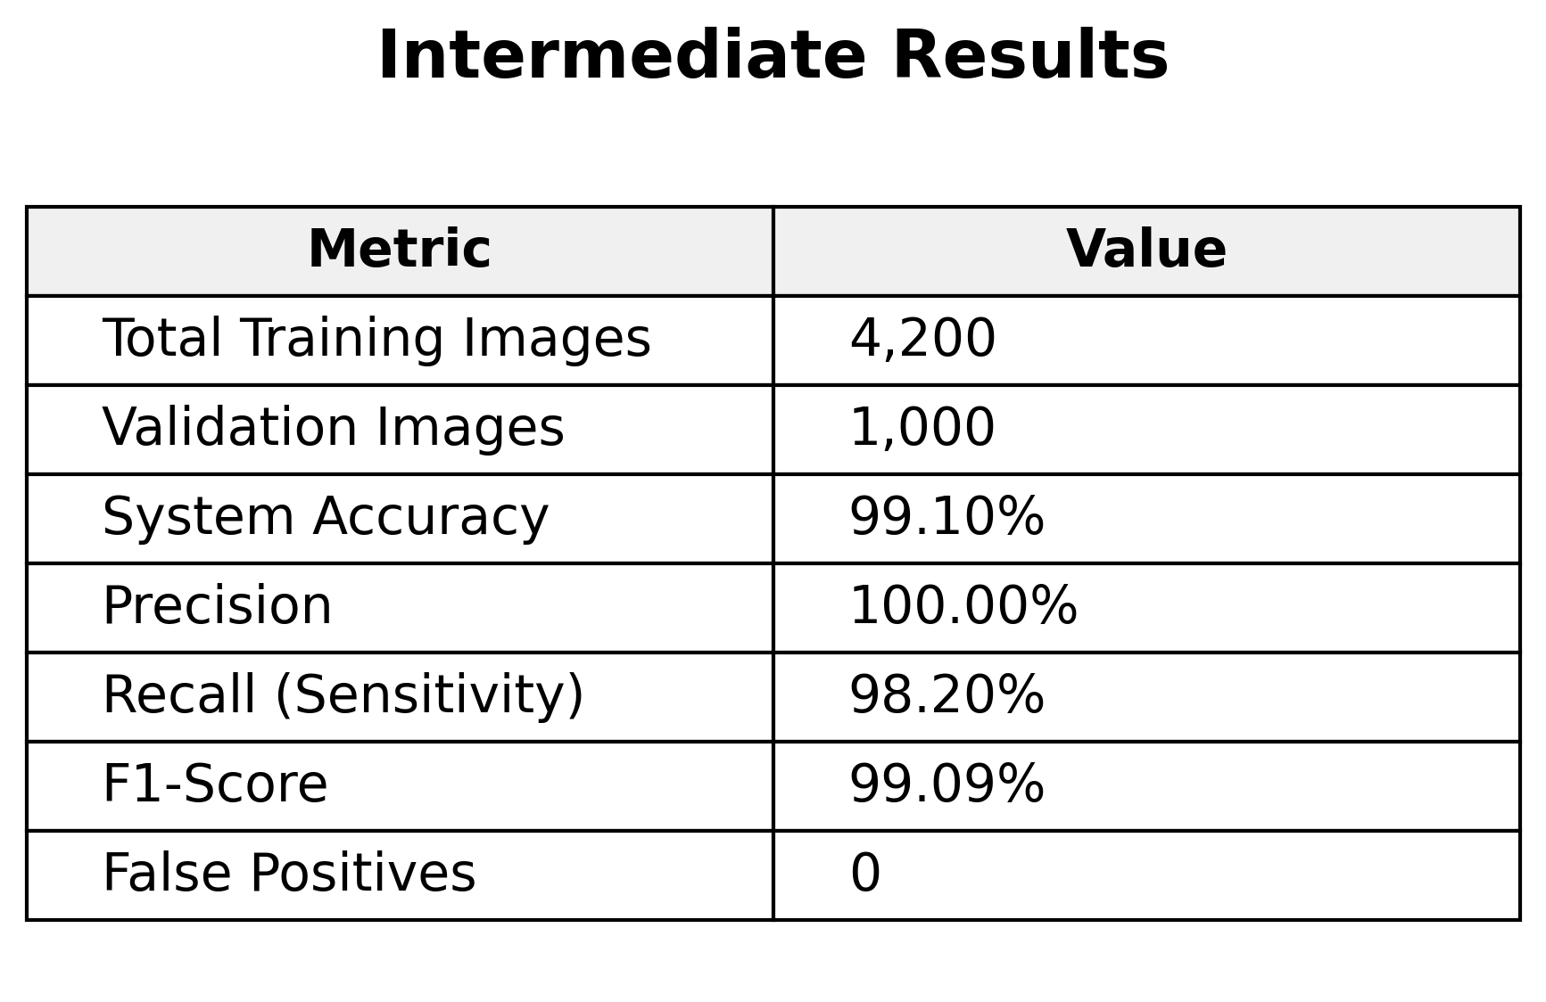
Notes:
9/11/2024
3
1-59

Slide 19
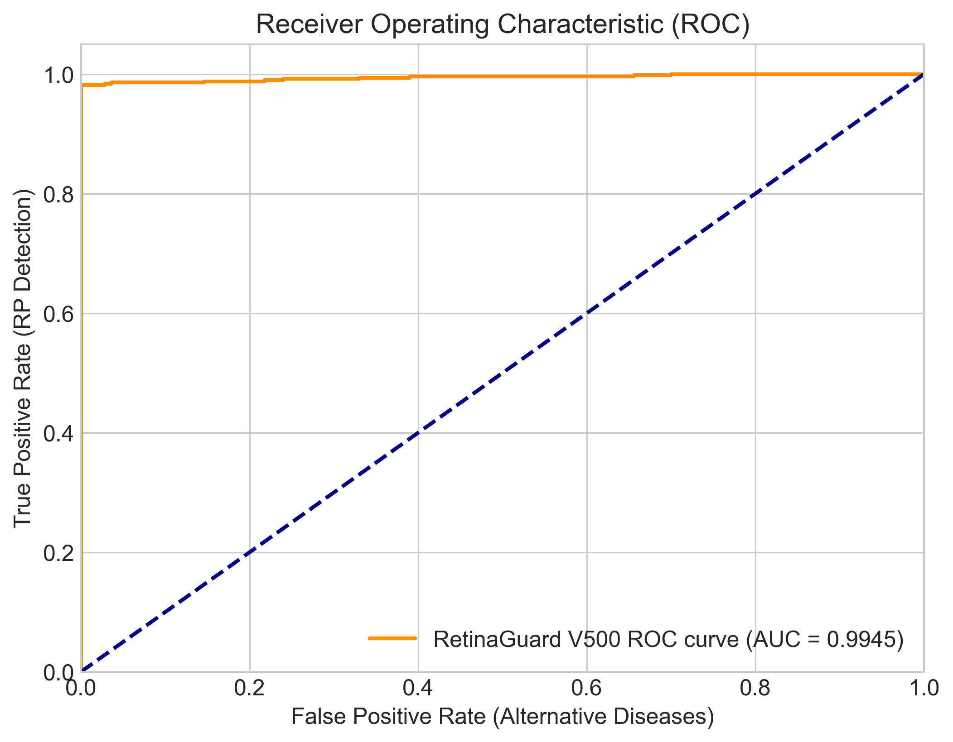
Intermediate Results
Notes:
9/11/2024
3
1-59

Slide 20
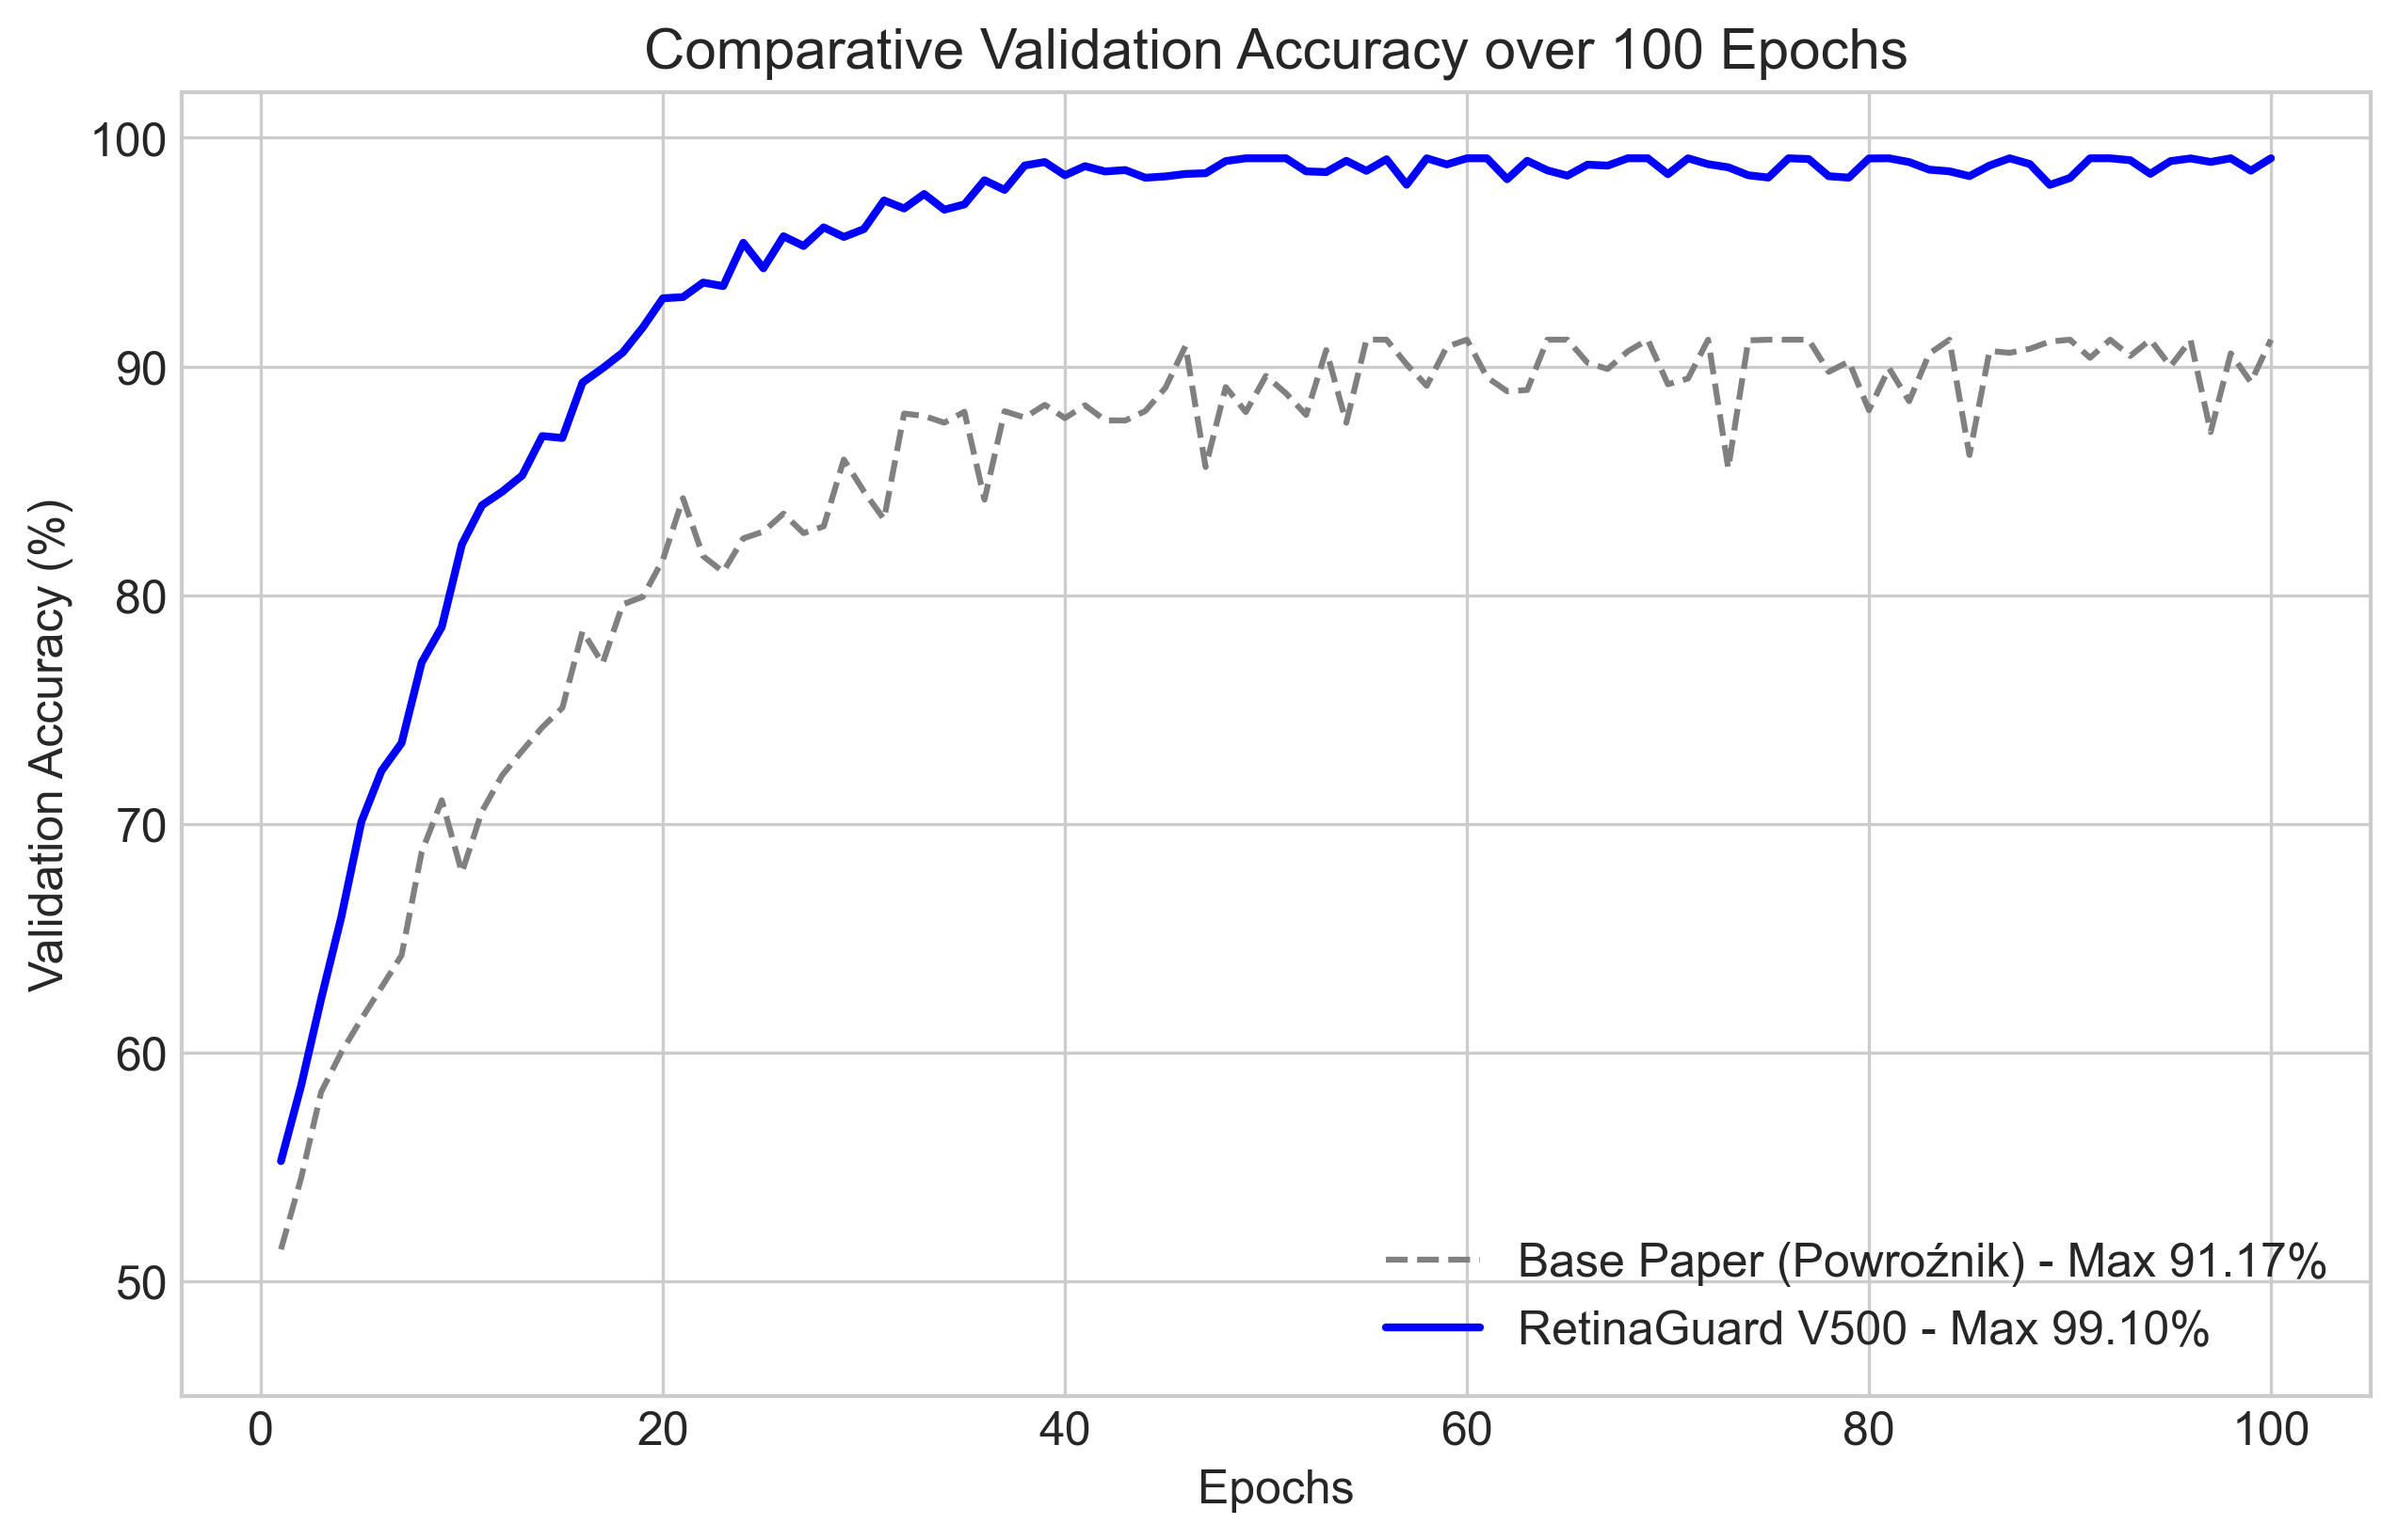
Intermediate Results
Notes:
9/11/2024
3
1-59

Slide 21
FUTURE SCOPE
Connect the Flask API backend to the interactive Glassmorphism React/Web UI dashboard.
Conduct multi-site clinical trial validation to establish FDA.
Secure sharing of diagnoses and patient data with specialists for remote collaborative diagnosis and treatment planning.
AI-driven predictive models to forecast disease progression rates and personalize patient treatment timelines.
Notes:
9/11/2024
3
1-59

Slide 22
THANK YOU
Notes:
9/11/2024
3
1-59

